Slide 1
Land Connected
Of Max Diniz Cruzeiro
LenderBook

Slide 2
There once was a boy who had learning difficulties at school,...
LenderBook

Slide 3
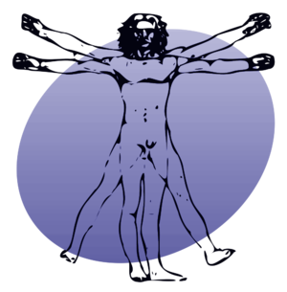
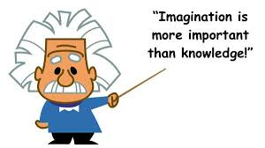
So scientists gathered all technologies to solve this global problem.
LenderBook

Slide 4
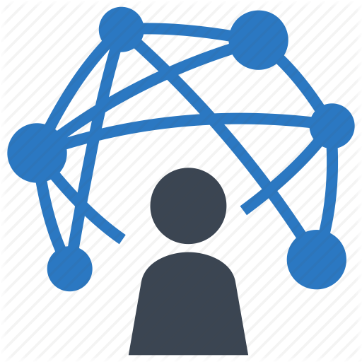
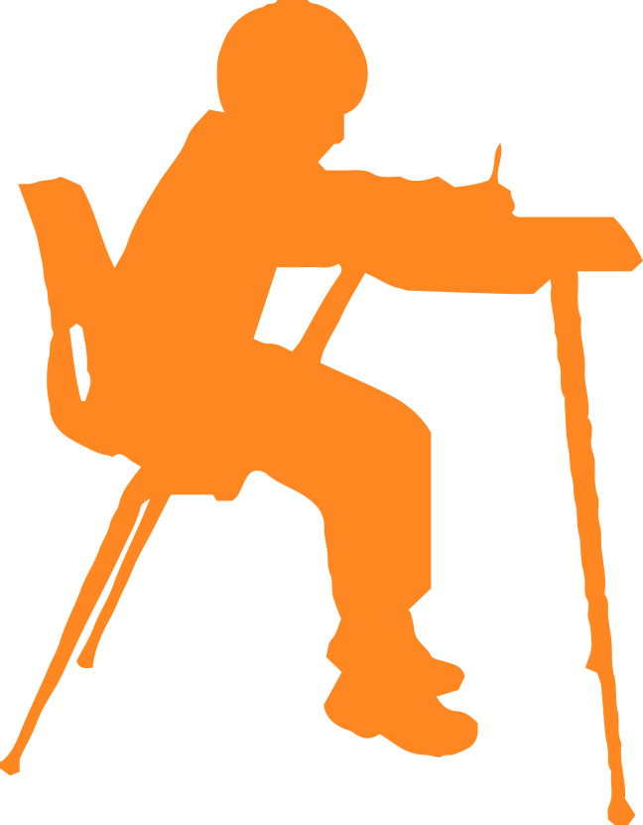
And the scientist connects radio waves that caught the necessity boy and interconnected in the library.
LenderBook

Slide 5
But the scientist warned the boy that connected land demanded that this had respect for other human beings because his thought could now be seen.
LenderBook

Slide 6
And the child grew and became a highly intelligent and has worked wonders on earth conquering the universe.
LenderBook

Slide 7
Ending ... From a beginning that is not ended.
LenderBook

