Slide 1
The Solar System Oranges
A Thought Multilinear
By Max Diniz Cruzeiro - LenderBook®

Slide 2
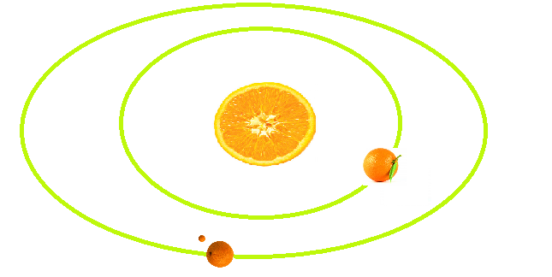
It was once a solar system composed only of oranges.
LenderBook®

Slide 3
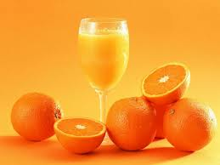
The whole system was used for the production of juice.
LenderBook®

Slide 4
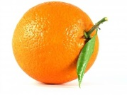
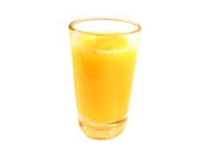
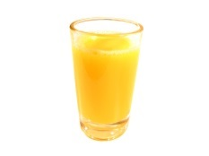
When all was a linear thought things worked well: each unit produced orange juice identical and homogeneous.
2 oranges + 2 oranges
=
4 units juice
+
=
LenderBook®

Slide 5
But came the chaos after the first billion years and oranges dried:
2 oranges + 2 oranges
=
0 units juice
+
=
LenderBook®

Slide 6
The chaos continued and 2 billion years oranges changed homogeneity:
2 oranges + 2 oranges
=
5 units juice
+
=
And sometimes gave 4 oranges ½ cup juice, 7 cups sometimes, sometimes none. It was the end of the predictability of production.
LenderBook®

Slide 7
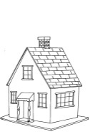
Desperate, the scientists on the 3rd billion years decided to channel production to hide the facts of the population. And so we created a logic.
Pumped up the juice industry one day but not the other. For two neighborhoods procedure supply was established at 7:00 am and a third quarter due to the distance the juice only arrived at 7:30 and was in continuous supply until 8:00.
Residents living near the factory were privileged because they spent more time connected to the supply of juice and did not complain. The residents of the third quarter in addition to waiting for more juice were the first to run out of the product when the level of the aqueduct lowered after the plant stops pumping.
Possible logical states:
0 0 0
1 1 0
1 1 1
LenderBook®

Slide 8
But in other cities the arrangement of neighborhoods in relation to the plant forced scientists to develop other logical pumping of orange juice.
In this city pumping juice reached the first district at 07:00 am, the second at 07:30 and the third at 08:00 and 09:00 was interrupted supply.
Possible logical states:
0 0 0
1 0 0
1 1 0
1 1 1
LenderBook®

Slide 9
And pumping problems were becoming more complex due to the arrangement of neighborhoods in each city regarding their factories.
LenderBook®

Slide 10
And so everyone was happy in front of a table laden with many jars of orange without knowing the breakdown of homogeneity in the volume of units that were produced juice.
A happy society, within the ignorance!
And for all continued to maximum 2 + 2 = 4
Note: That nobody dares challenge!
LenderBook®

